Slide 1
Analysis and reduction in overall time frame of prognostication of Cancer detection, diagnosis and treatment with Big Data Analytics using Prescriptive Analysis.

Slide 2

National Institute of Electronics & Information Technologys
Presentation by
Team G7:
Reena Balwant S Sidhaling Chavan Vishal B. Hooli Ankit Nagdeve

Slide 3
Contents
Introduction
Abstract and Purpose
Study Analysis in Areas of delay
Cancer Statistics
Requirement Gathering and Analysis
Technologies to be used
What is a Big Data
Scope of Study
Research Methodologies
Research Study
Data simulation
Results
Conclusion

Slide 4

Introduction
Cancer is a group of diseases involving abnormal cell growth with the potential to invade or spread to other parts of the body
Cancer remains one of the leading causes of morbidity and mortality worldwide. It is predicted that by 2020, the number of new cases of cancer in the world will increase to more than 19 million, with deaths increasing to 12 million
Cancer is a major burden of disease worldwide. Each year, tens of millions of people are diagnosed with cancer around the world, and more than half of the patients eventually die from it

Slide 5
Abstract and Purpose
Our project research study with MCC(Malabar Cancer Center), is to focus on speeding up on the cancer detection & diagnosis test results & process which is causing delay in initiating therapy & actual treatment by driving targeted and innovative research using "Big Data Analytics" with measurable results in an accelerated time frame
To finding a way to overcome scientific and therapeutic roadblocks to improve cancer treatment and cures to deliver the potential for cancer patients to lead long healthy lives
Efforts to promote early detection continue to be the major focus in fighting cancer. Since early detection is associated with decreased mortality, one would think that it is important to minimize delays in detection and diagnosis

Slide 6
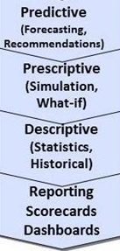
Study Analysis in Areas of delay
There are two major types of delay.
Patient delay is delay in seeking medical attention after self-discovering a potential cancer symptom
System delay is delay within the health care system in getting appointments, scheduling diagnostic tests, receiving a definitive diagnosis, and initiating therapy
To Analysis and reduction in overall time frame of prognostication of Cancer detection, diagnosis and treatment with Big Data Analytics using Prescriptive Analysis. And also Efforts to promote early diagnosis continue to be the major focus in fighting cancer

Slide 7
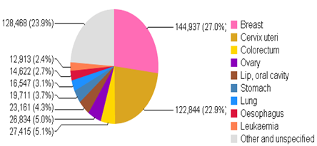
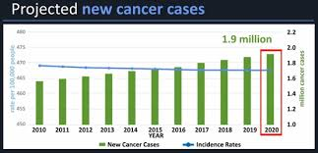
Cancer Statistics

Slide 8
Requirement Gathering and Analysis
Required Data Source:
Medical data set that includes data pulled from a variety of sources
Patient Samples Data
Clinical Registration Data
Pathology Data
Radiology Data
Lab Results Data
Oncology And Experimental Data

Slide 9
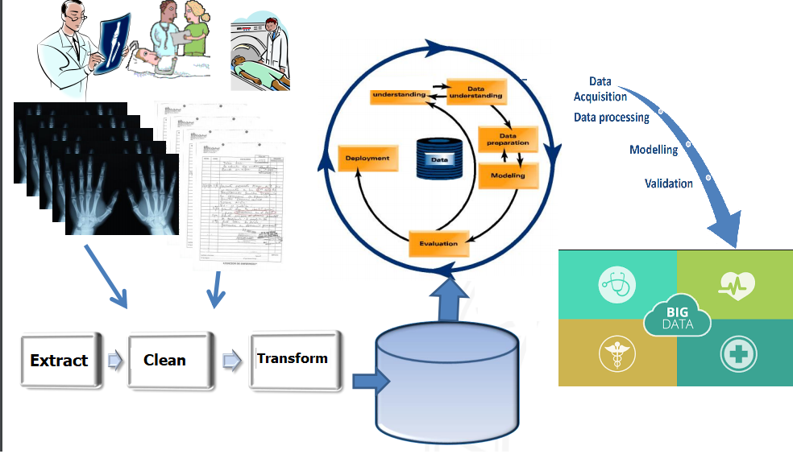
Research Methodologies and Design / Procedures

Slide 10
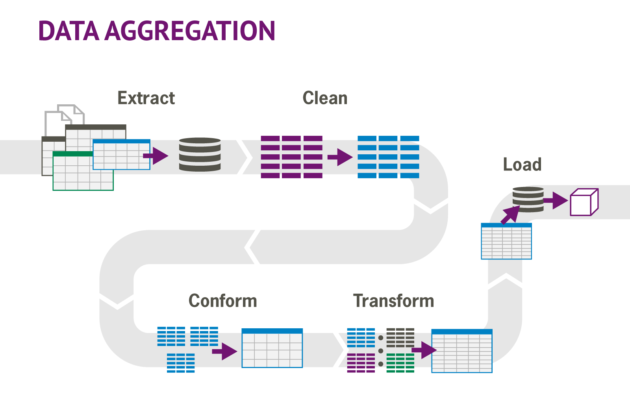
Research Methodologies
Research Methods:
Extracting and Retrieving data from Structured or unstructured data sources for further analysis and processing
Cleaning and Filtering of data
Transforming the data in proper format for querying
Performing various analysis and computation on the data / dataset to achieve desired conclusion
Define the analytical queries and algorithms required to generate the desired outputs

Slide 11
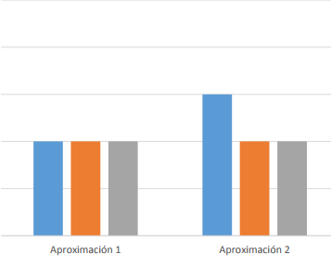

Technologies to be used
Programming Languages:
Python 2.7.21
Numpy
Scipy
Pandas
Mathplotlib
Seaborn
IDE
Jupyter Notebook

Slide 12
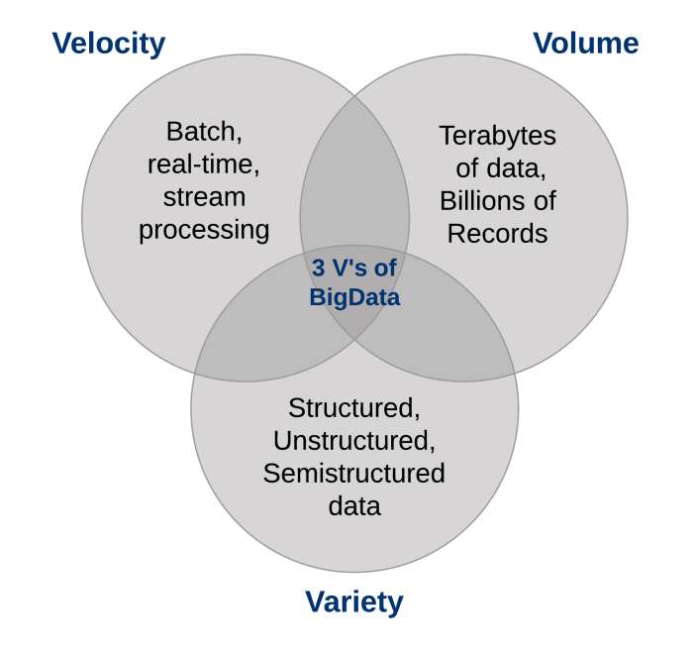
What is a Big Data??
Today, many organizations are gathering, storing, and
analyzing huge amounts of data
These data is known as a big data as it has Volume, Velocity
and Variety in the developed and developing world

Slide 13
Research Study
Research participants were cancer patients seeking medical care in medical centres in MCC, KMCT & Palliative Care Included were cancer patients
Delay in diagnosis & treatment may affect the survival of cancer patients. The purpose of this study is to investigate delayed diagnosis & treatment for cancer patients
The delays in cancer diagnosis may occur throughout the diagnostic pathway: patient, primary care, and secondary care
Patient delays may occur when the patient fails to recognise and act on suspicious cancer symptoms
Primary care delays may occur in the recognition, investigation, and referral for symptoms suspicious of cancer

Slide 14
Research Study
Primary care physicians are expected to identify patients with possible cancer at an early stage, but the diagnosis of cancer is relatively uncommon for individual primary care physician as more than 80% of patients present with non-specific symptoms
Indeed, the main concern of a primary care physician is to differentiate the minority of patients who need urgent attention from the majority of patients who are likely to have self-limiting conditions
In the hospital, delays can be due to the doctors delay in making a diagnosis and starting treatment. A doctors delay in making a diagnosis is defined as the time taken from primary care referral to diagnosis
Delay of treatment is defined as the interval between diagnosis and the start of treatment. Considerable diagnostic delay might occur if several invasive procedures are needed to confirm the diagnosis and the suitability for surgical treatment

Slide 15
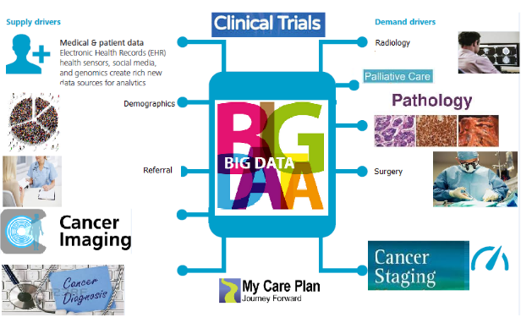
Dataset Modules (Data Simulation)

Slide 16
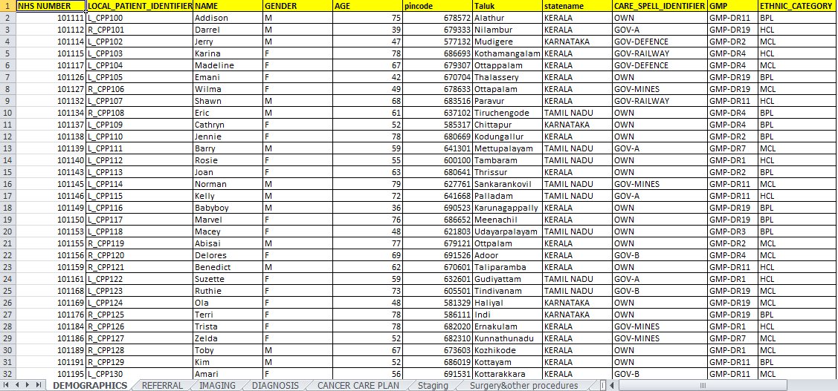
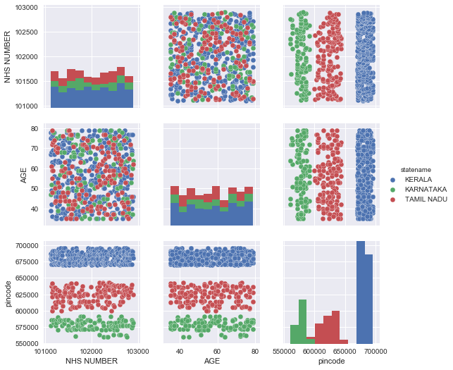
Research Methodologies
DEMOGRAPHICS DATASET
DEMOGRAPHICS PLOTS
NHS NUMBER LOCAL PATIENT IDENTIFIER
ORGANISATION CODE (CODE OF PROVIDER) CARE SPELL IDENTIFIER
PERSON FAMILY NAME PATIENT USUAL ADDRESS (AT DIAGNOSIS)
POSTCODE OF USUAL ADDRESS (AT DIAGNOSIS) SEX
BIRTH DATE GMP (CODE OF REGISTERED OR REFERRING GMP)
CODE OF GP PRACTICE (REGISTERED GMP) ORGANISATION CODE (RESPONSIBLE PCT) ETHNIC CATEGORY
DEMOGRAPHICS SCHEMA

Slide 17
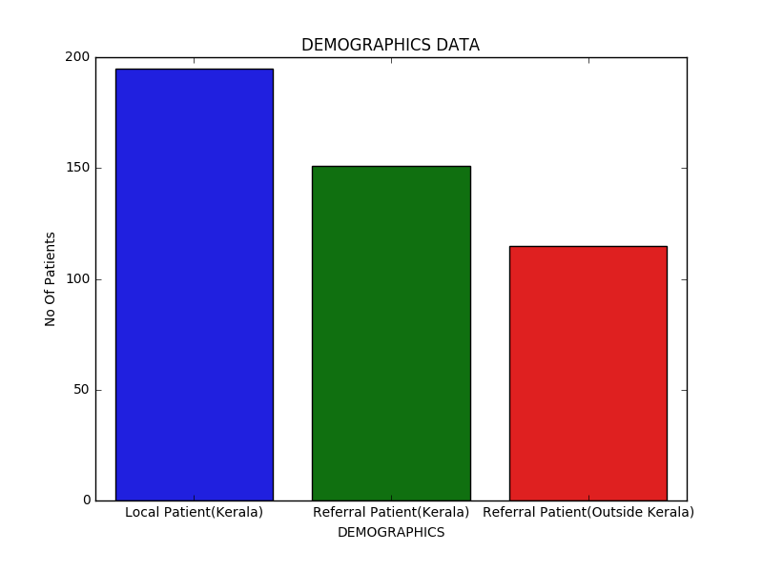
Research Methodologies
Plotting of Graphs on Data set of Time Delay Analysis Using Pandas, Matplotlib and Seaborn in python.
Demographics Plots

Slide 18
Research Methodologies
Similarly data sets and Graphs are Generated for following tabs:
Referral
Imaging
Diagnosis
Cancer care plan
Staging
Surgery & other procedures
Pathology Details
Chemotherapy & other drugs
Radiotherapy (Teletherapy)
Radiotherapy (Brachytherapy)
Palliative care
Clinical Trials
Clinical Status Assesment
Death Details

Slide 19
Scope of Study Analysis
Analysis will give clear insight to the root causes
& loopholes behind the delay to start medication on
cancer patients, which ultimately going to help healthcare
organization to optimize their services in effective ways
&save thousands of life of cancer patients
The convergence of computing and medical technologies in these and other cancer research methodologies, to increased benefits from big data analytics in the fight against cancer
Process and quality management
Building and learning health care systems

Slide 20
Data collection & Statistical analysis: Patients Categories:

Slide 21
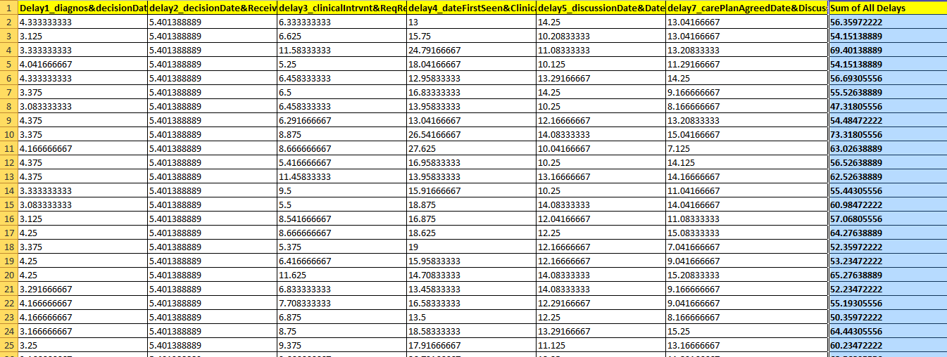
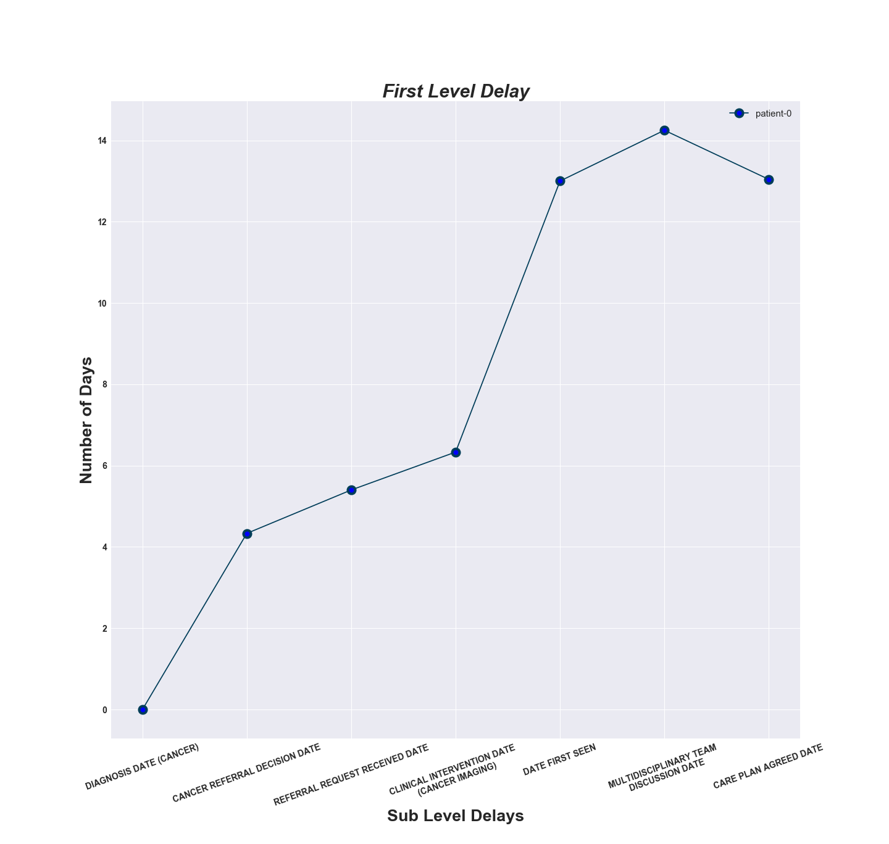
First Level Delays: Diagnosis Date (Cancer), Referral_desion_date, Referral_request_received_date_df, Clinical_intervention_dates (cancer_imaging),date_first_seen,multidisciplinary Team Discussion Date, Care Plan Agreed Date

Slide 22
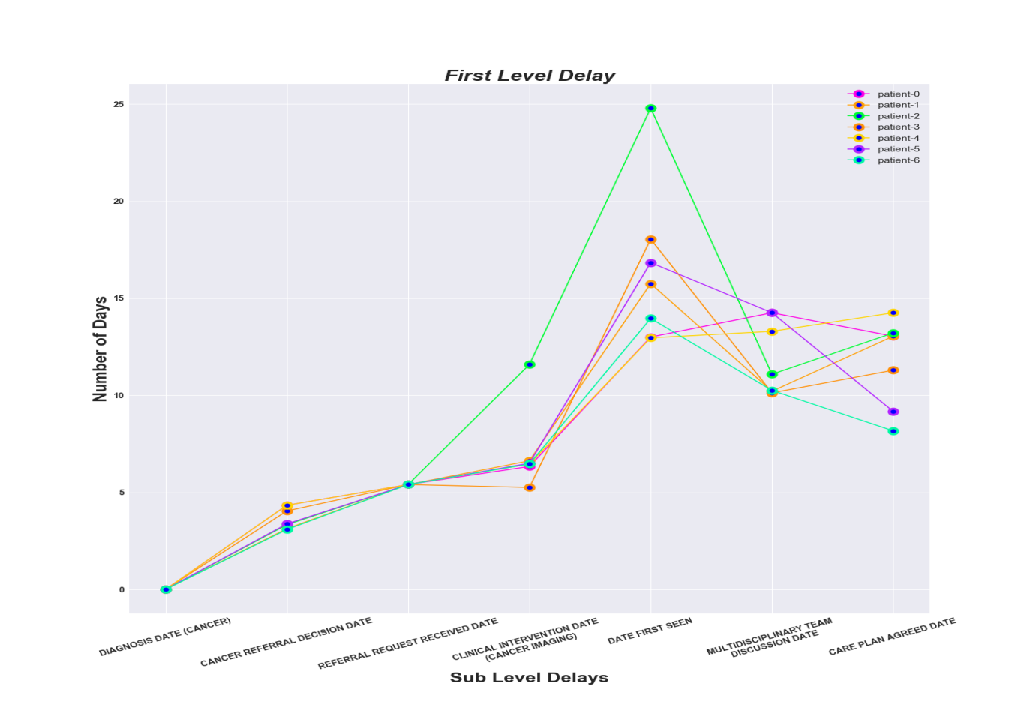
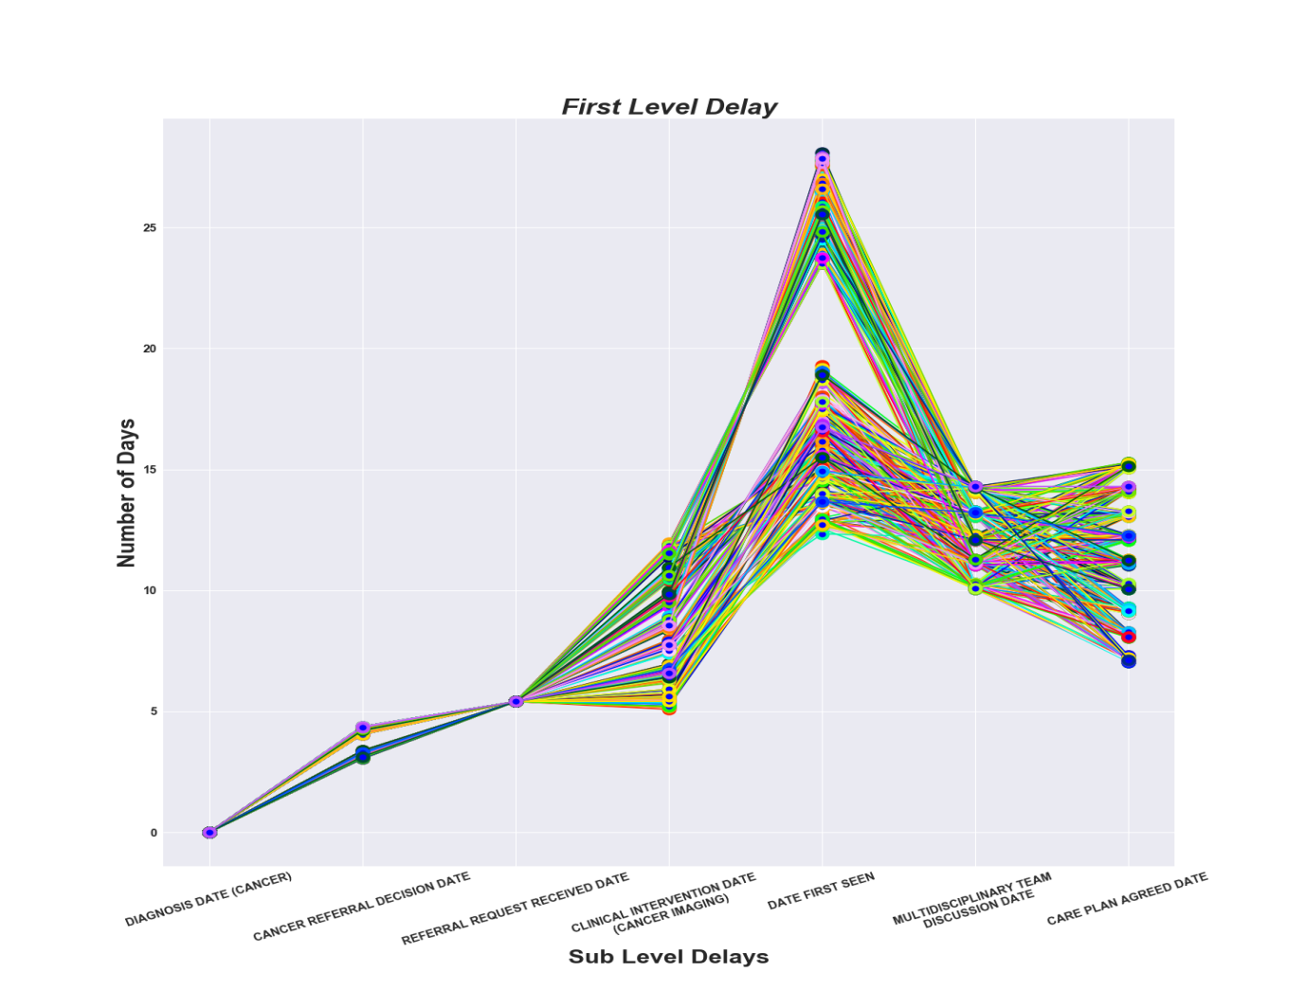

Slide 23
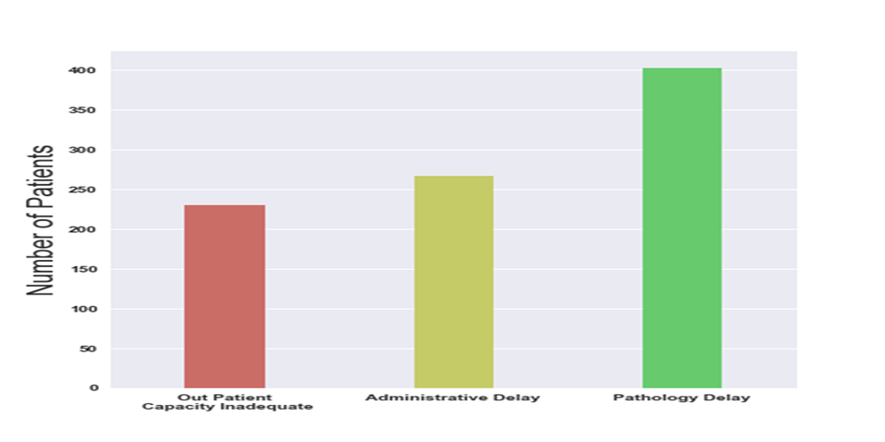
Areas of First Level Time Delay Analysis

Slide 24
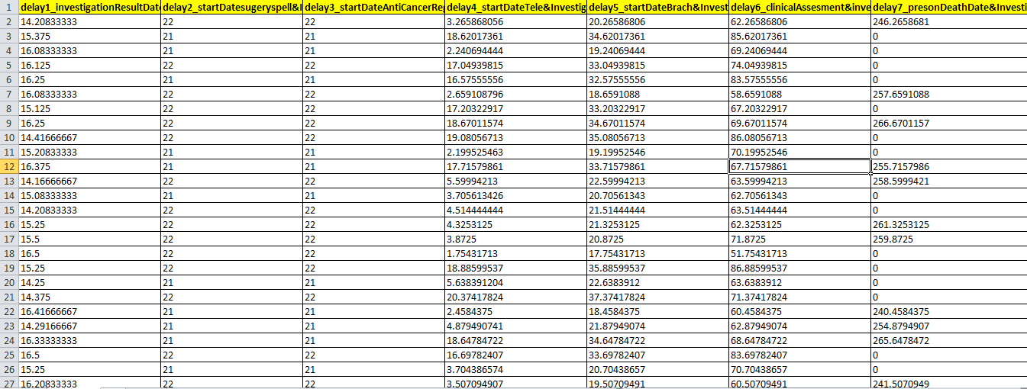
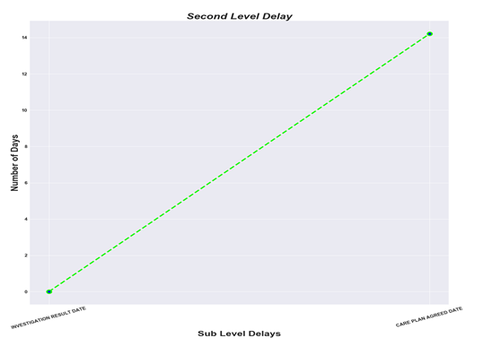
Second Level Delays: Investigation Result Date, Care Plan Agreed Date

Slide 25
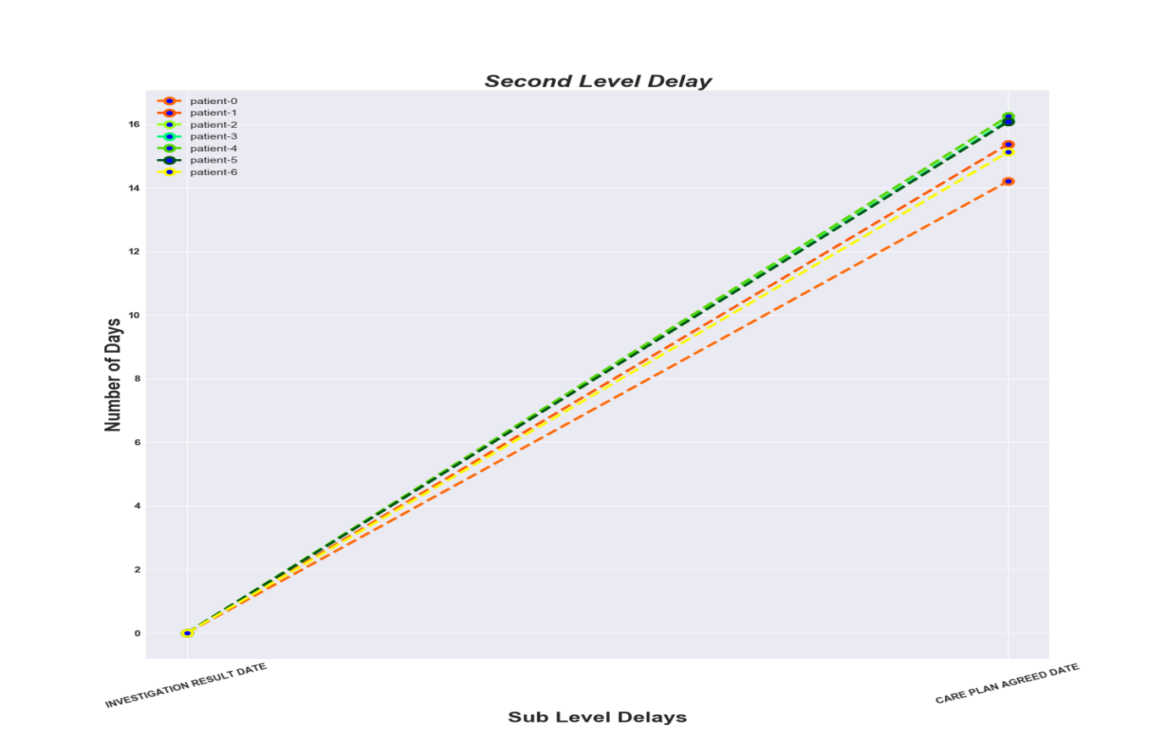
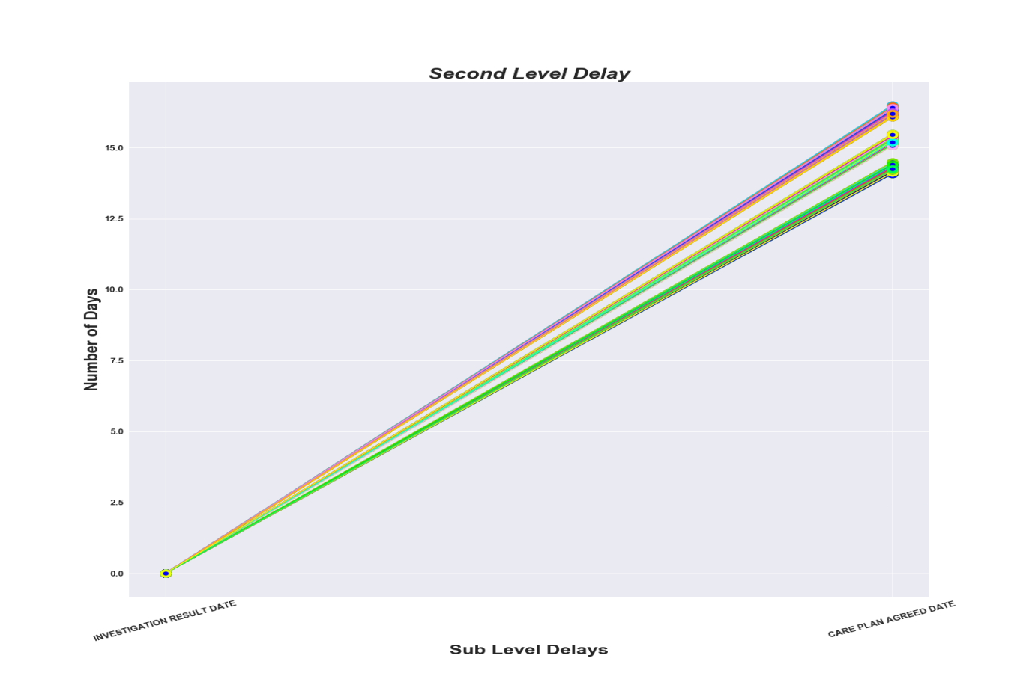

Slide 26
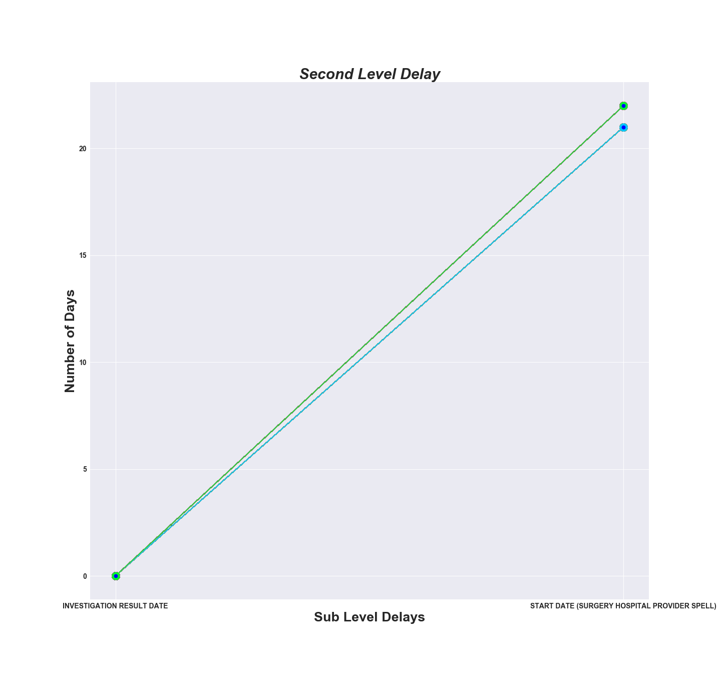
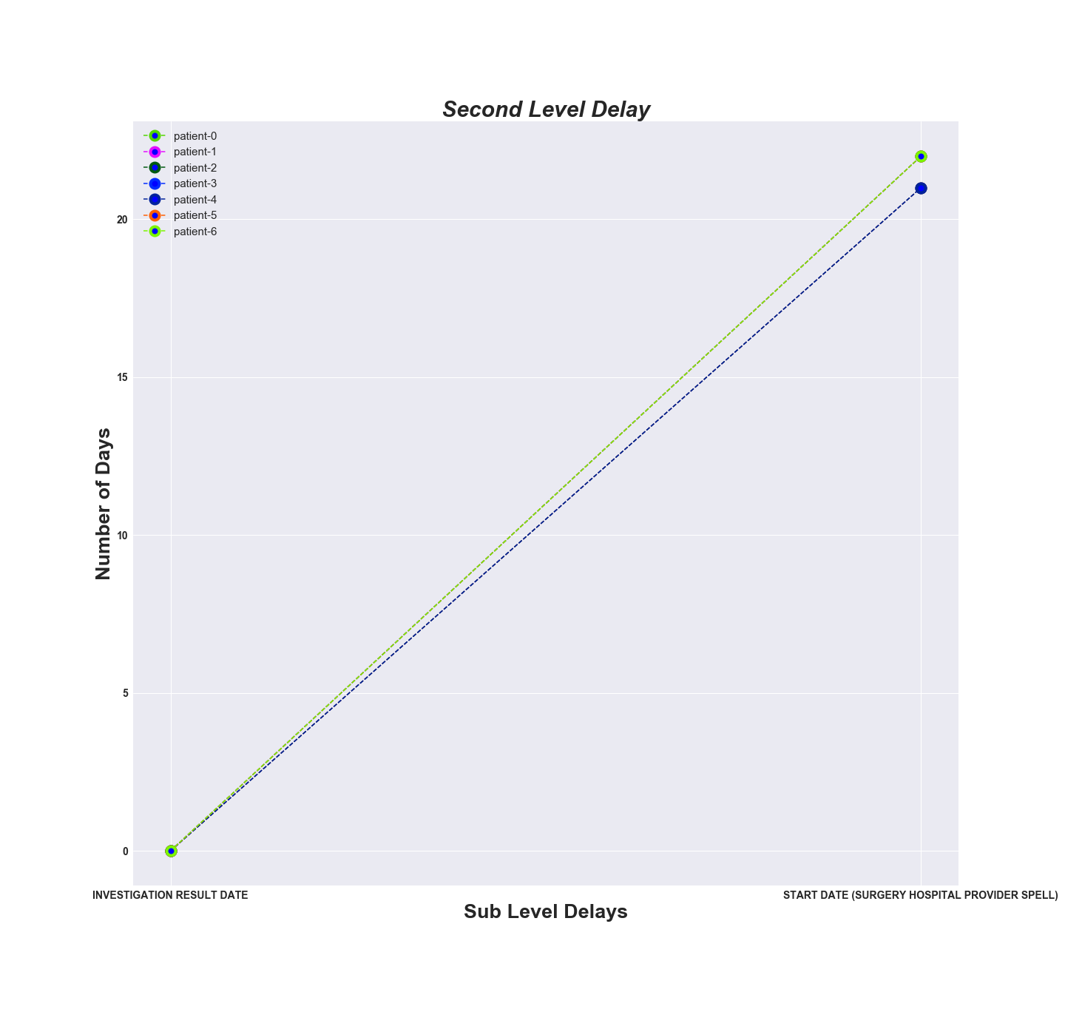
Investigation Result Date, Start Date (Surgery Hospital Provider Spell)

Slide 27
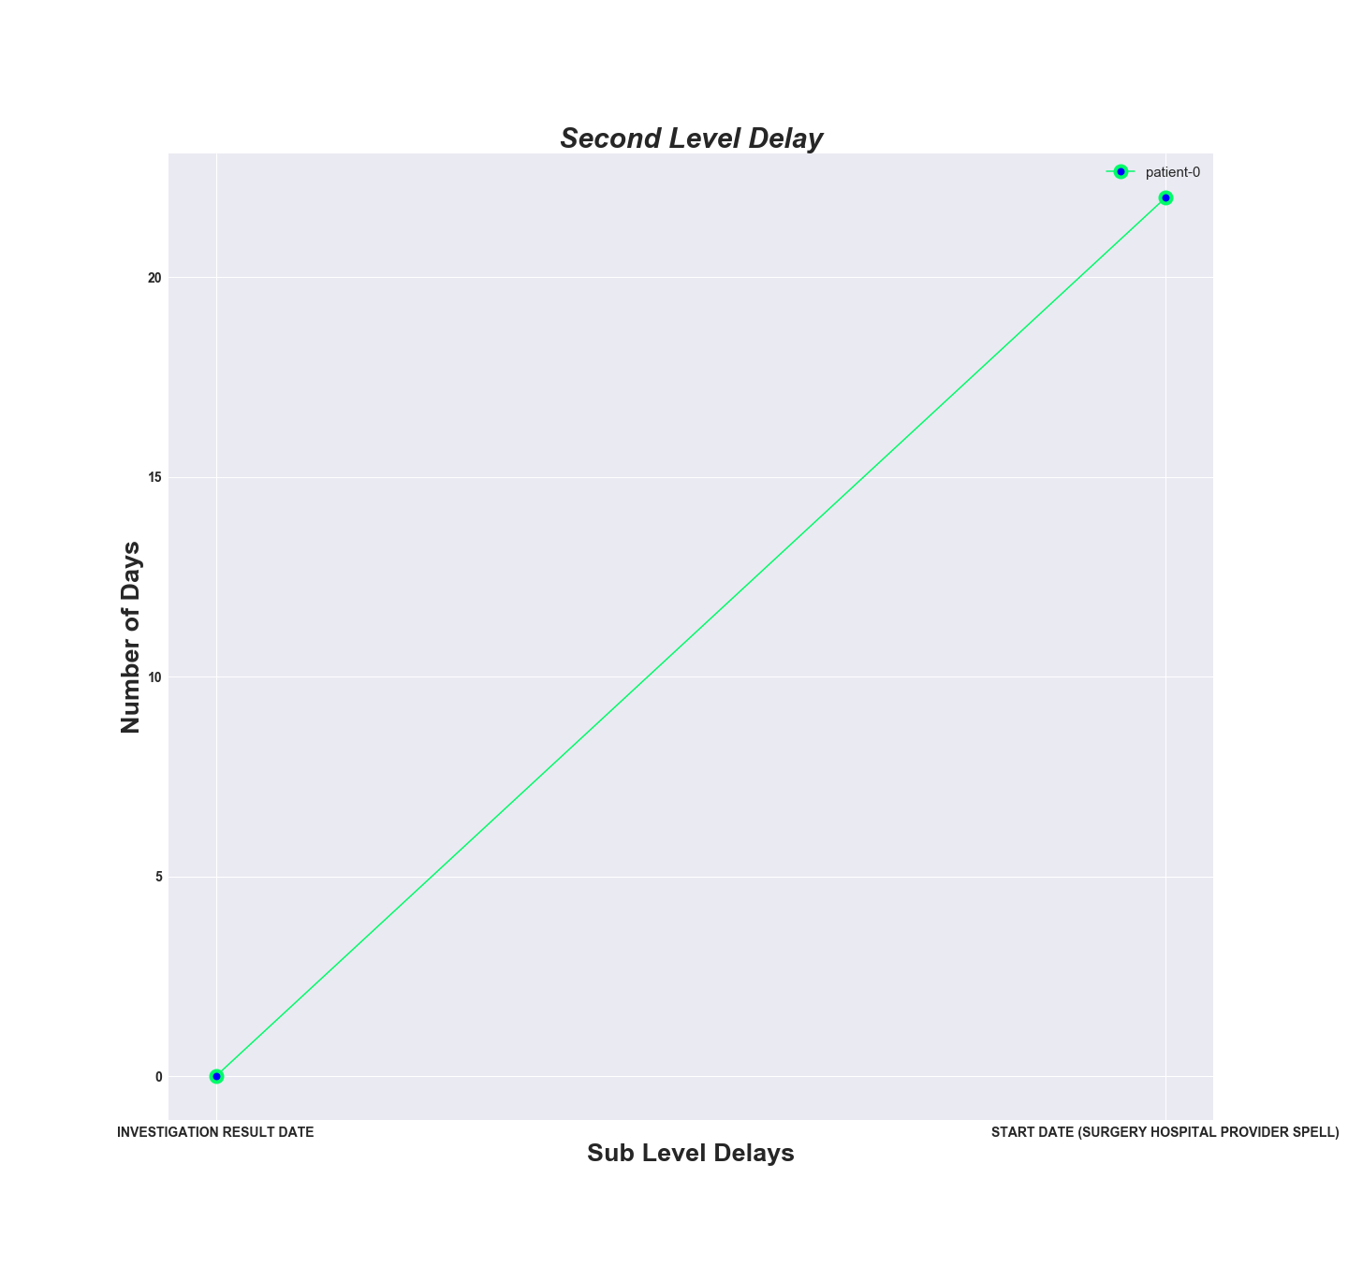

Slide 28
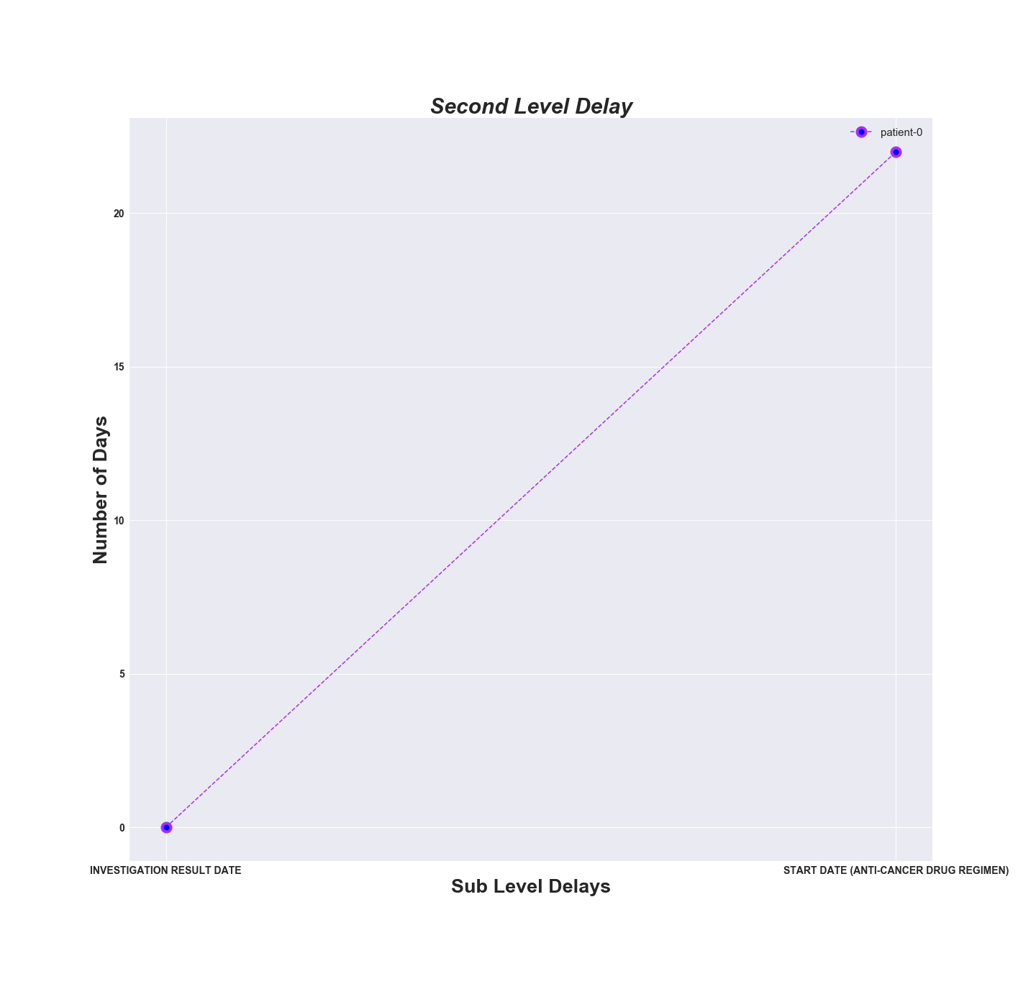
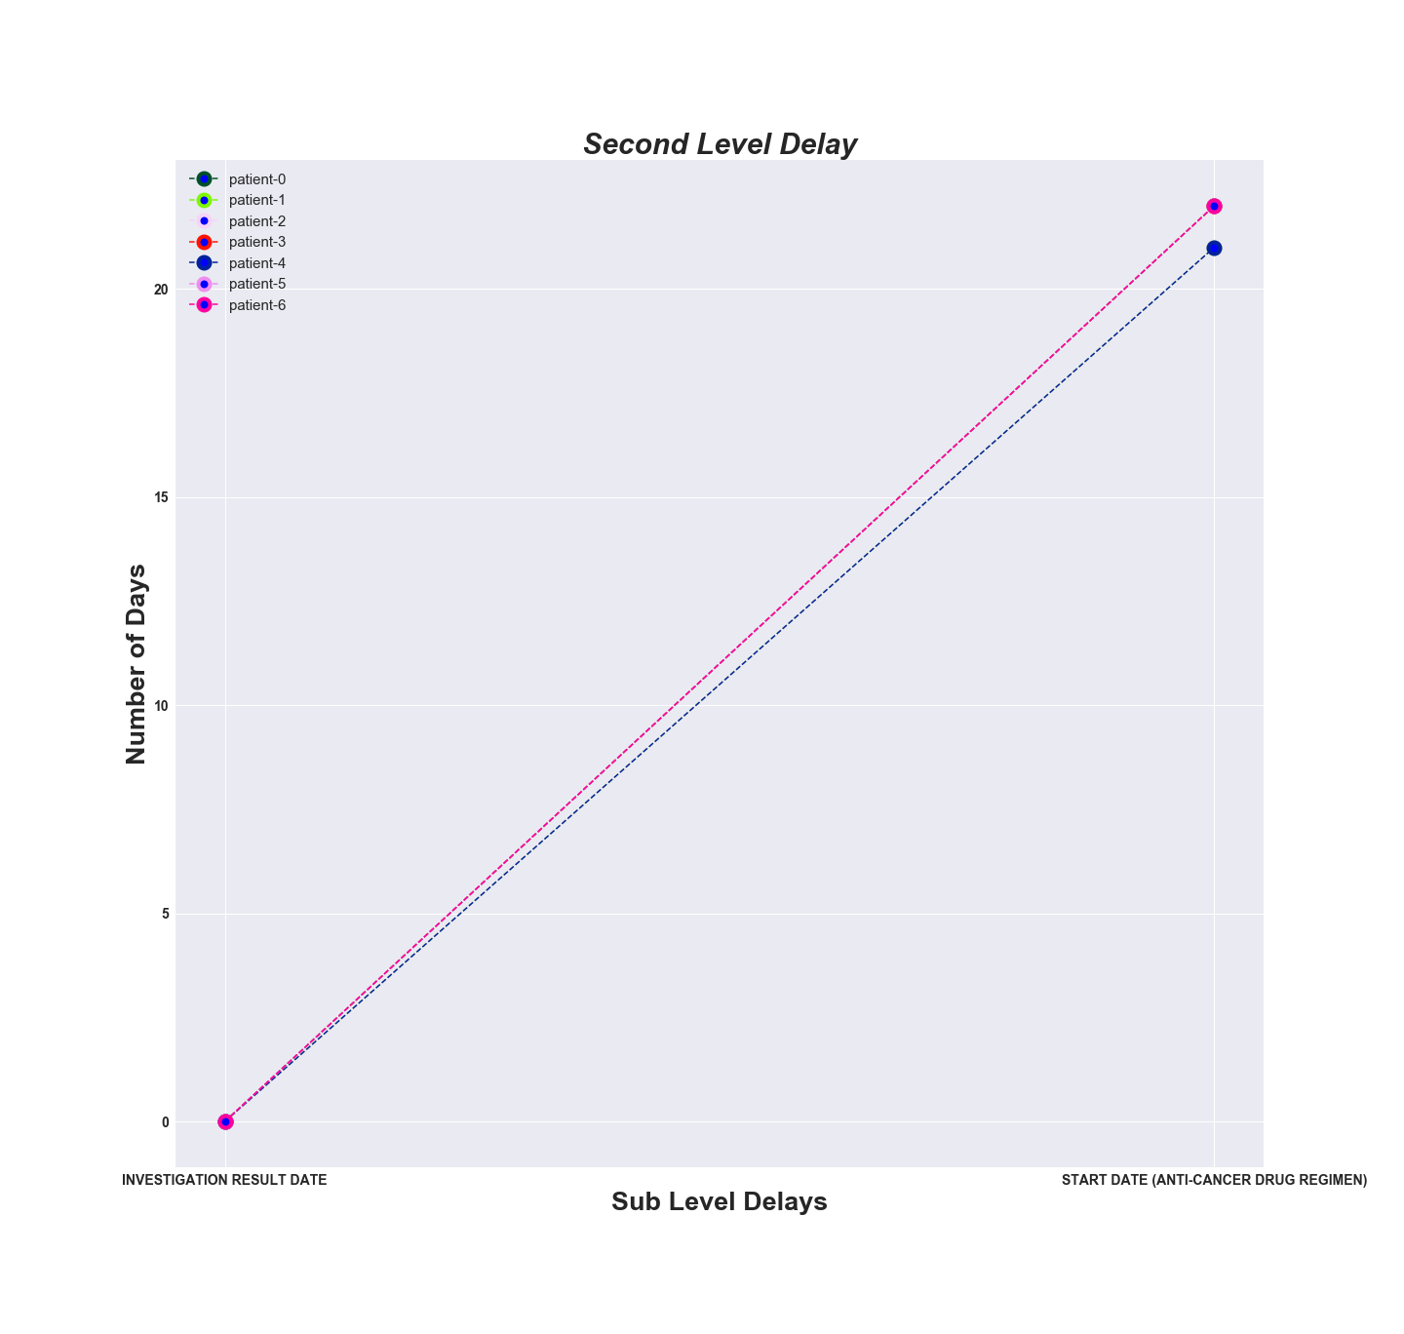
Investigation Result Date, Start Date (Anti-cancer Drug Regimen)

Slide 29
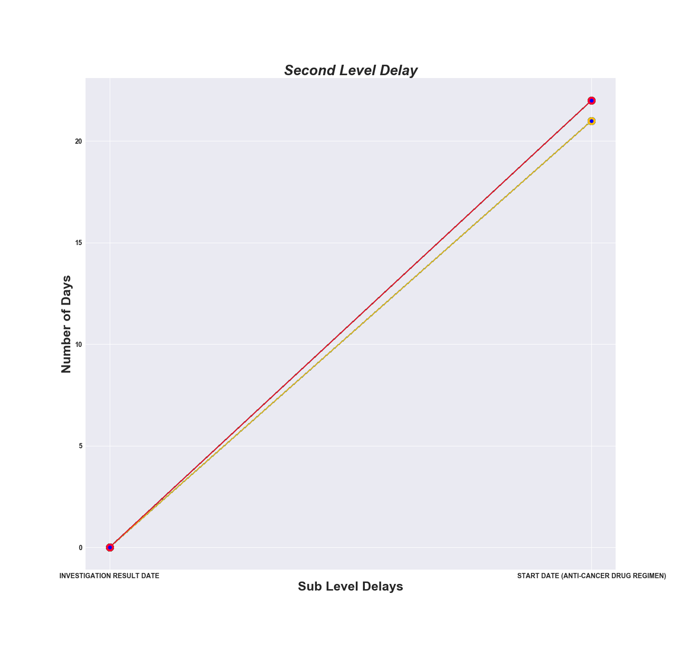

Slide 30
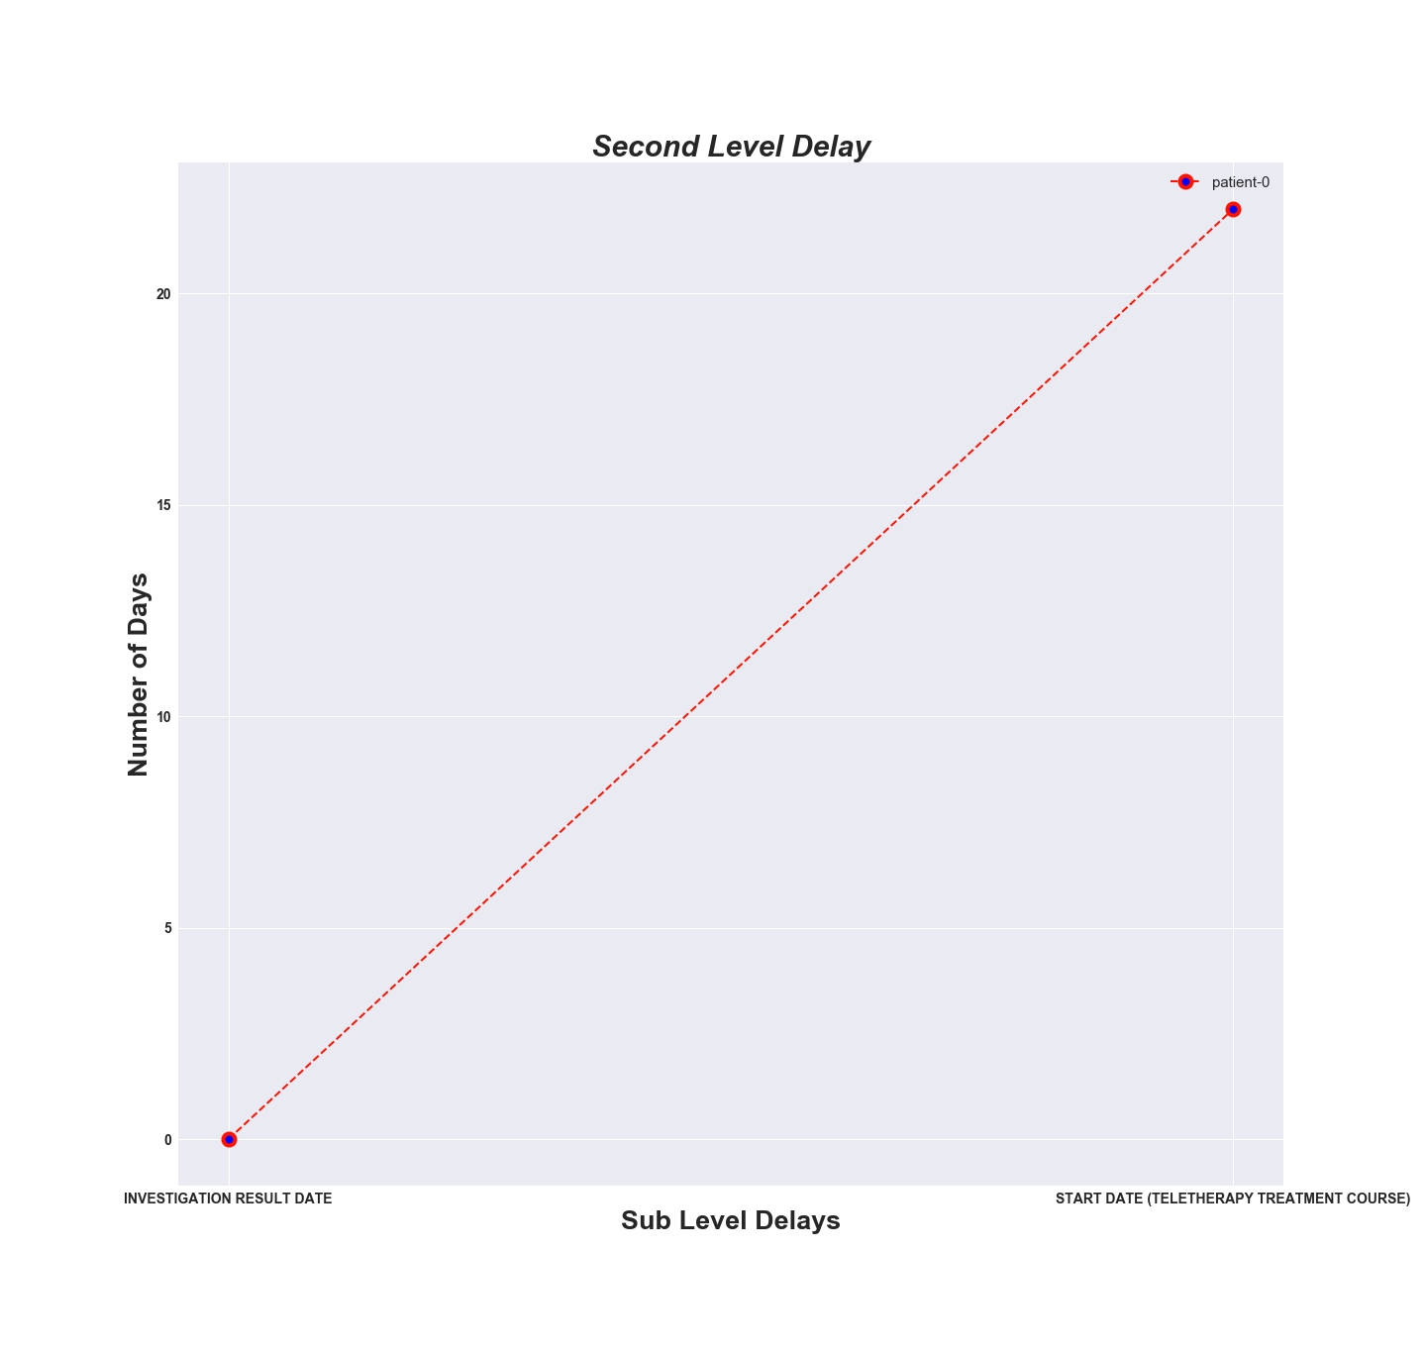
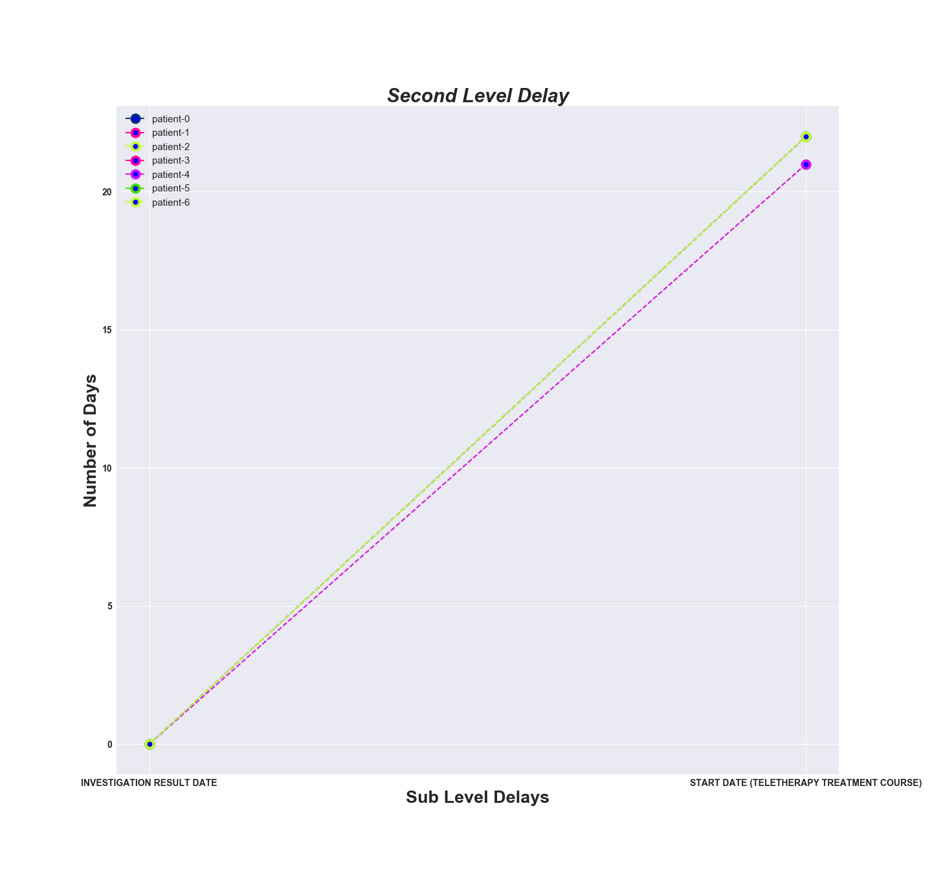
Investigation Result Date, Start Date (Teletherapy Treatment Course)

Slide 31
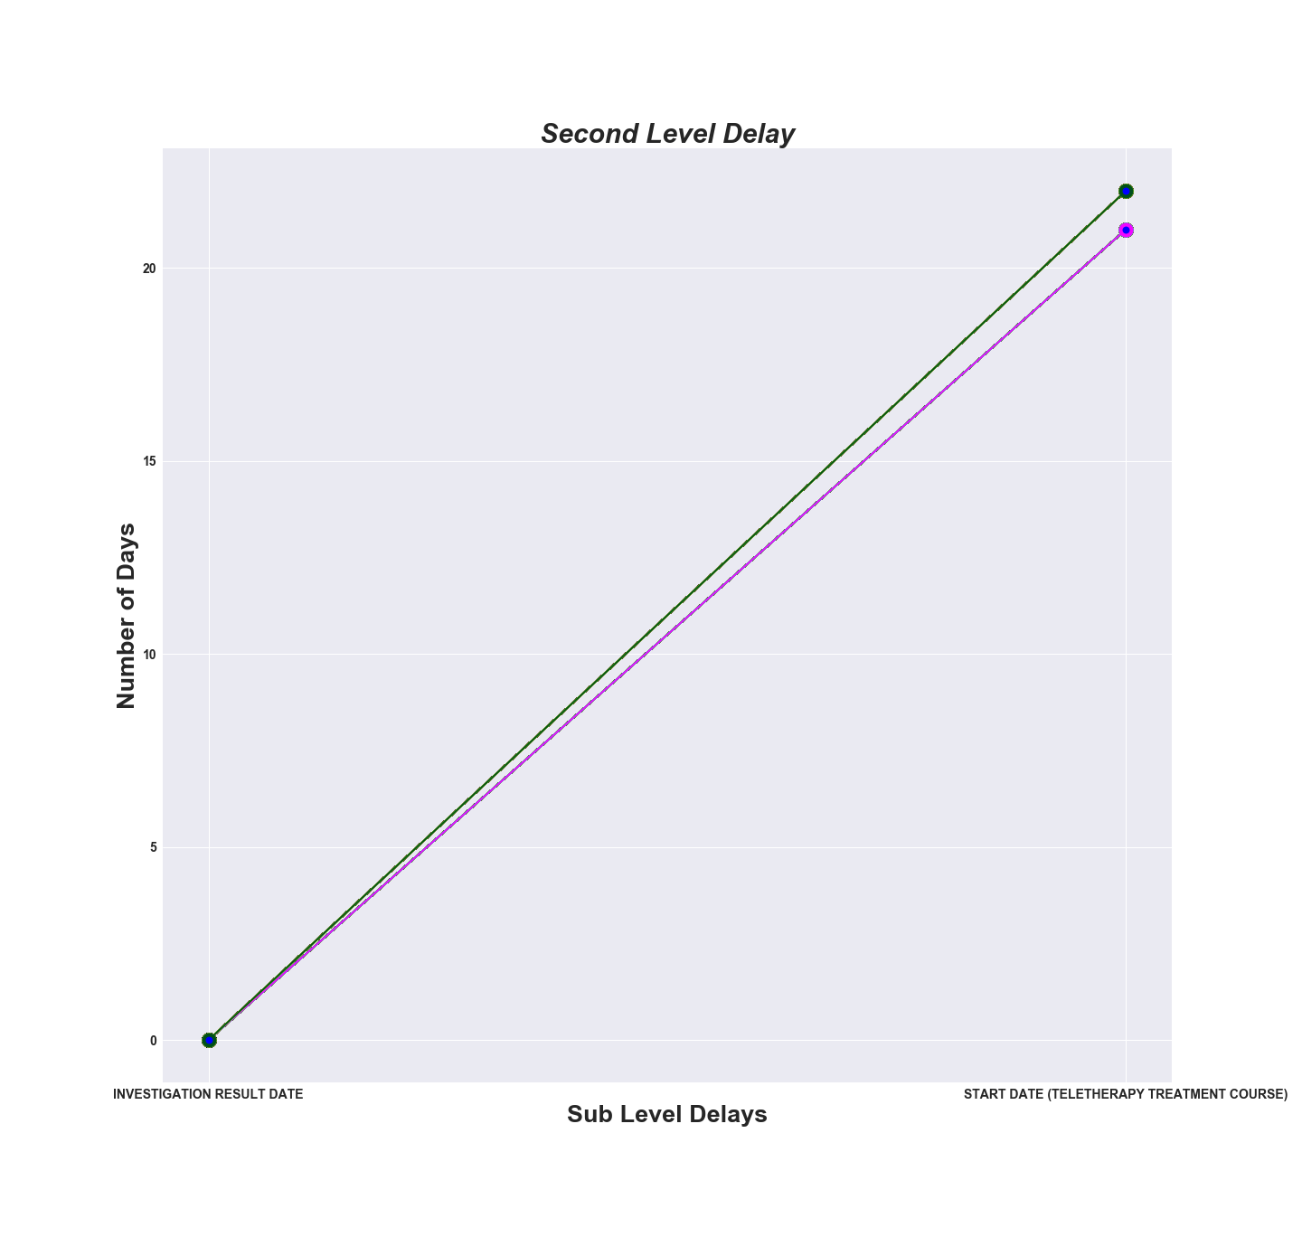

Slide 32
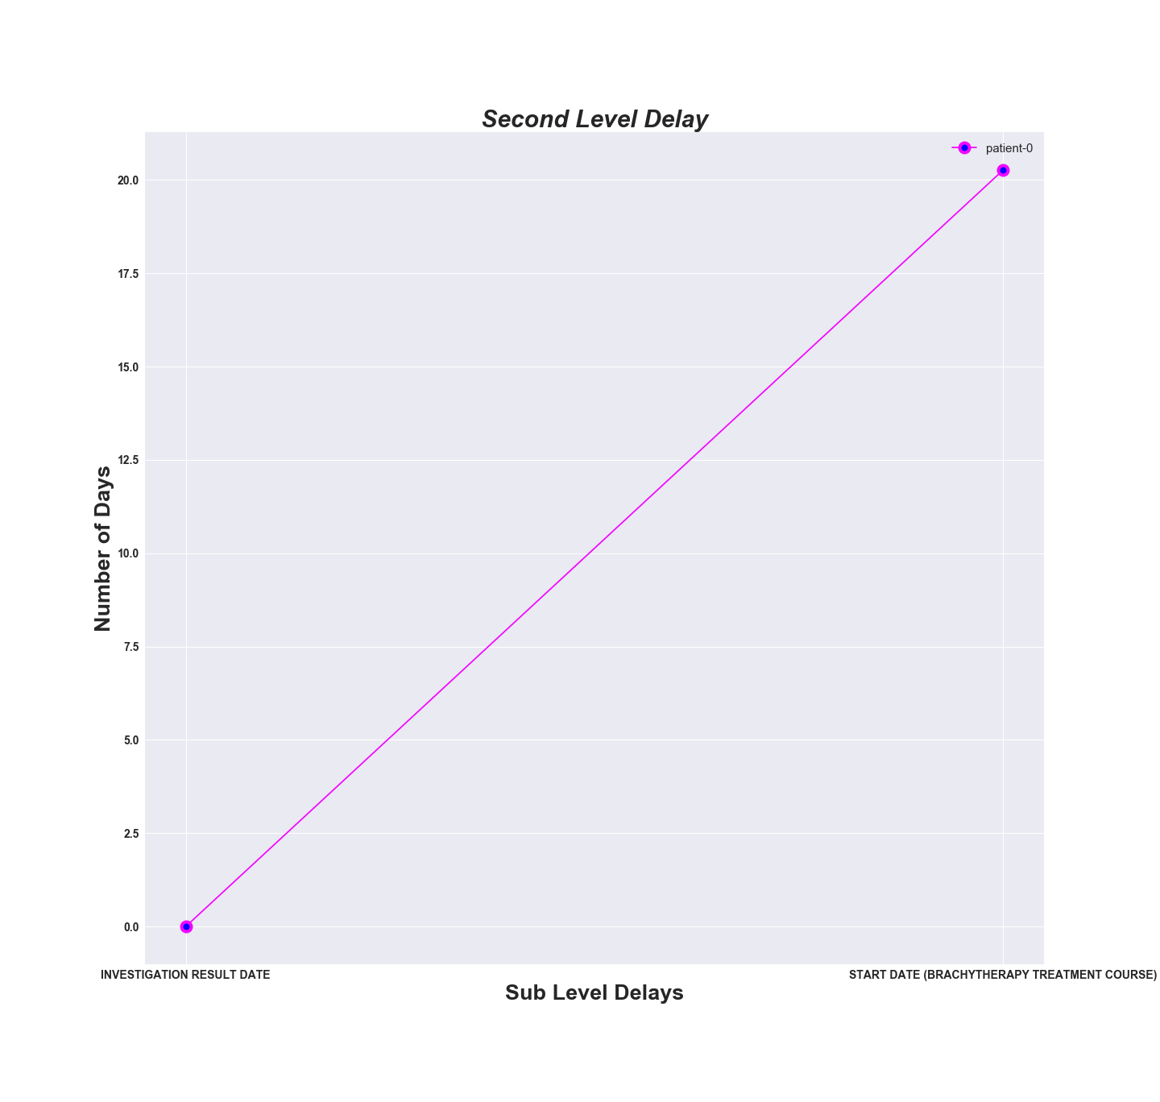
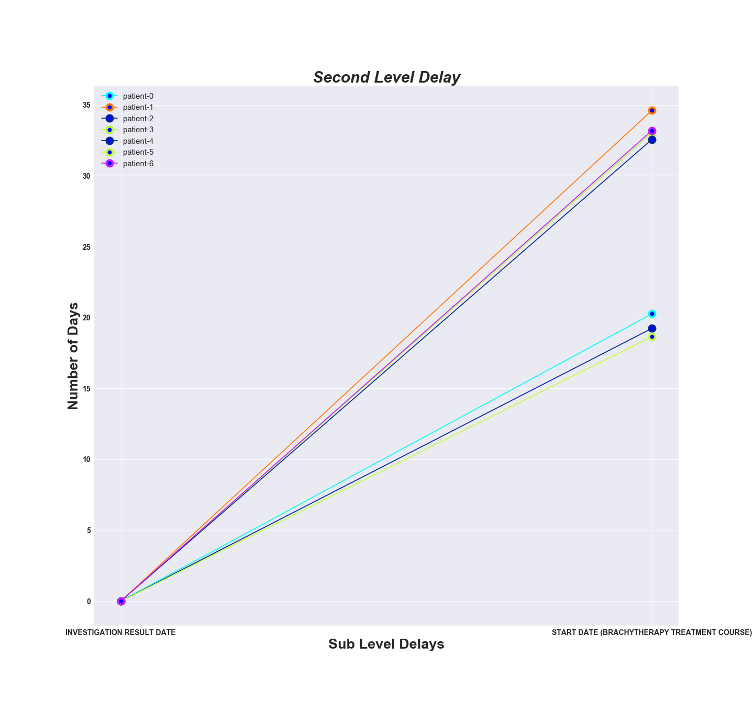
Investigation Result Date, Start Date (Brachytherapy Treatment Course)

Slide 33
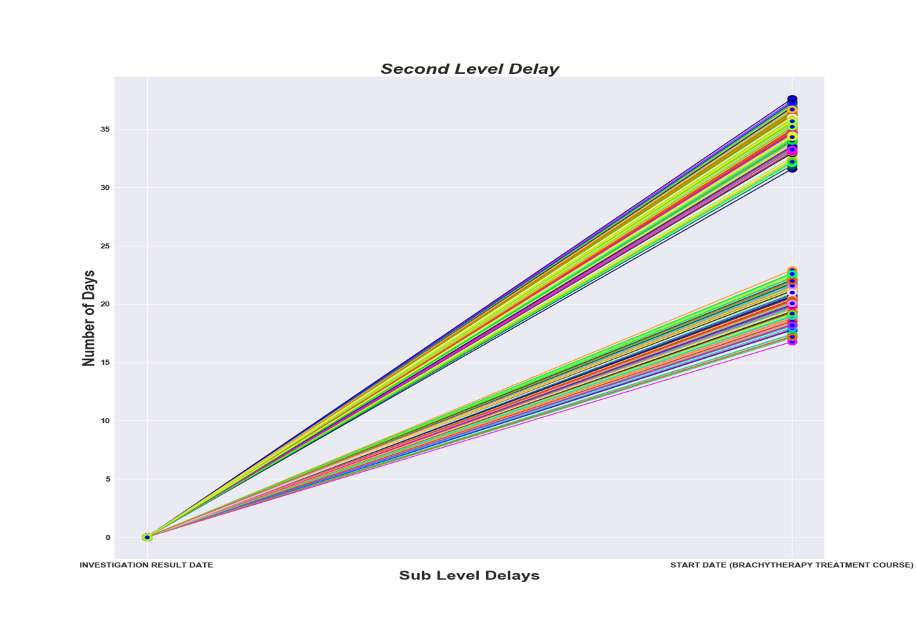

Slide 34
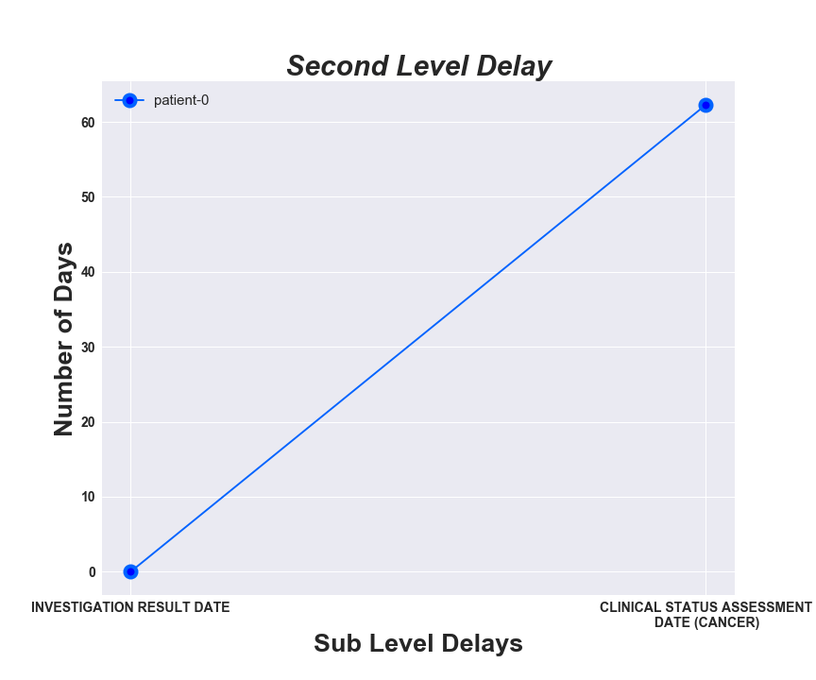
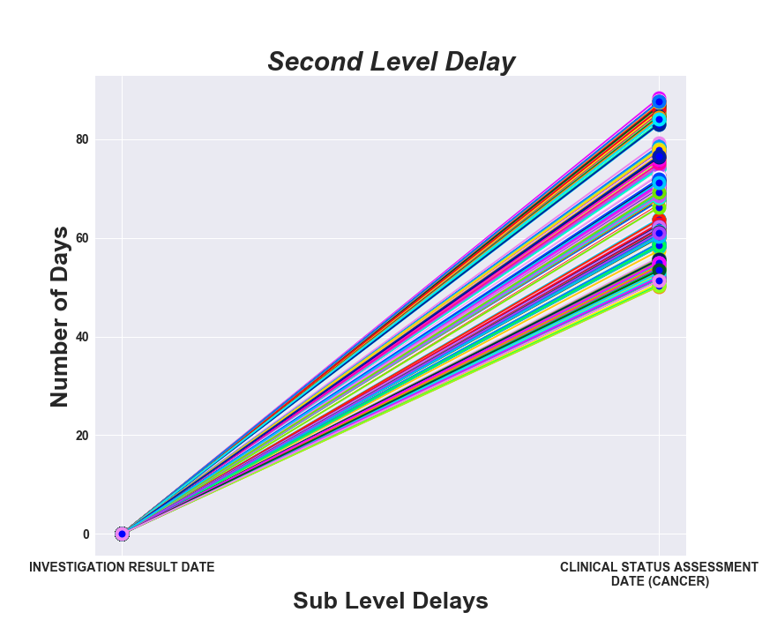
Investigation Result Date- Clinical Status Assessment Date (Cancer)

Slide 35
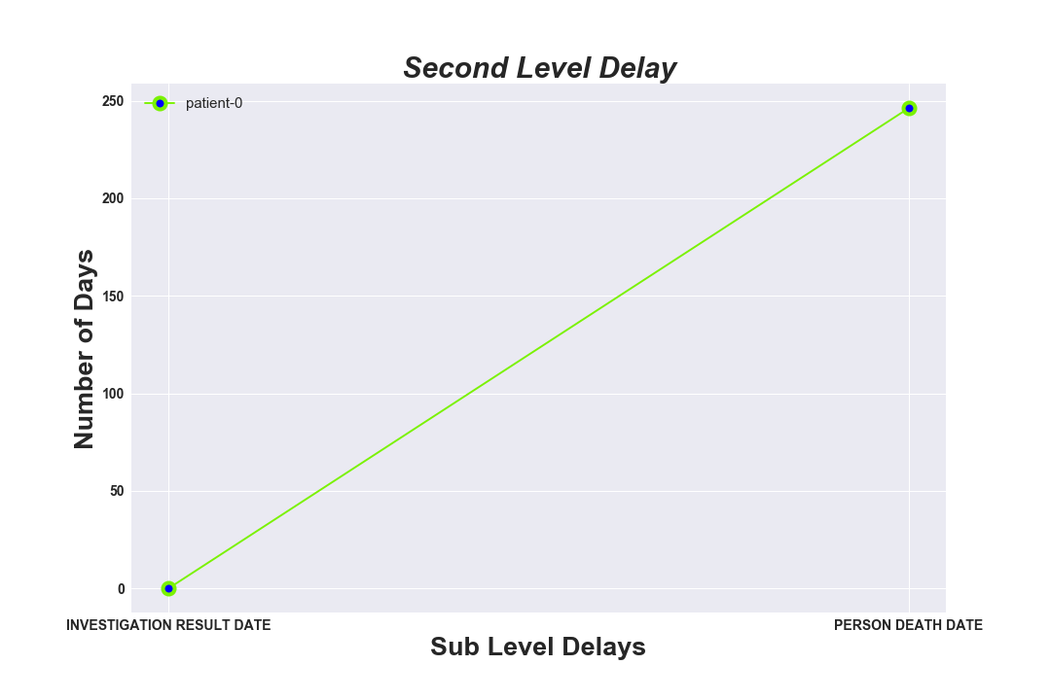
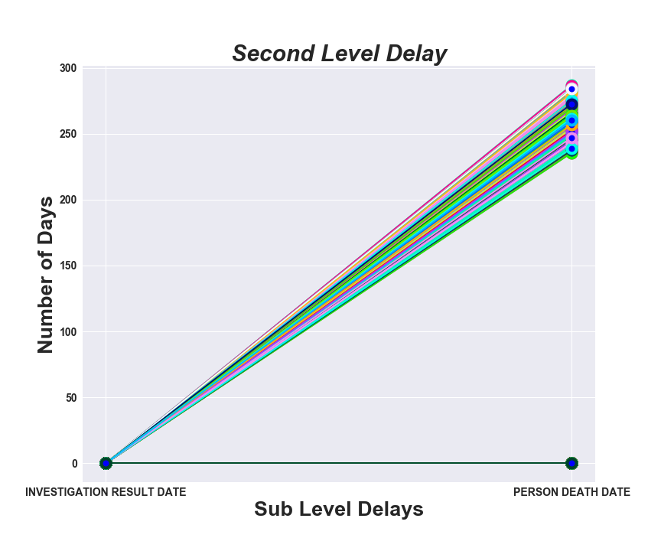
Investigation Result Date, Person Death Date

Slide 36
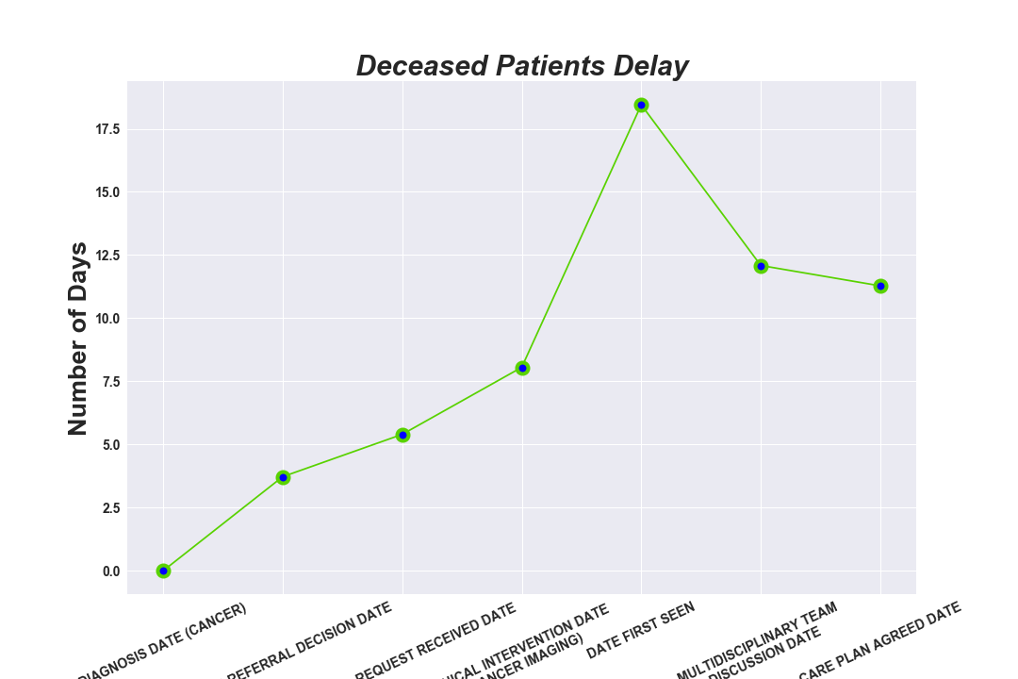

Slide 37
Results:
Average delay in cancer diagnosis was 27.8 days. Service level of the patients' first visit and number of hospitals patients visited before obtaining a correct diagnosis were significantly associated with delay in diagnosis
Logistic regression analysis found that patients who had visited two, and three or more hospitals before getting a correct diagnosis had longer delays in diagnosis than patients who had visited one hospital (odds ratio = 2.23 and 9.26, 95% confidence interval 1.37–3.63 and 95% CI:3.87–22.15,respectively).

Slide 38
Conclusion
Results of this study are anticipated to serve as a reference for the government and medical institutions to develop policies to reduce the number of delay occurrences shown in our study research for cancer patients, and ultimately to achieve the goal of early detection and treatment
A delay in cancer diagnosis can occur at various levels, The patient may fail to recognise suspicious cancer symptoms or act on them
The primary care physician may not recognise patients with suspicious cancer symptoms and investigate them appropriately or refer on time

Slide 39
Conclusion Continue…..
Patients with suspicious cancer in secondary care may not be seen on time, or they may be referred to the wrong specialty
Regularly updating primary care physicians about alarming symptoms of cancer, developing guidelines to identify these symptoms, promoting continuity of care, and enabling access to specialist expertise through prompt referrals should all help to prevent delays in cancer diagnosis
Thus, using media to broadcast the message of awareness in the community should increase public knowledge of cancer symptoms and the importance of seeking timely medical attention

Slide 40

THANK YOU

